Slide 1
Internal Analysis on Bugs
VERSION 1.0
Jumbish Jain
Provider Experience & Tooling Team
Copyright © 1996-2023 Booking.com. All rights reserved. All references to “Booking.com”, including any mention of “us”, “we” and “our” refer to Booking.com BV, the company behind Booking.com™

Slide 2
AGENDA
Git repo
KVM /Environments
RBAC / Passport
Rollouts
DB Tool Configuration
Intellij license version
Service Directory
Flog/Elastic Search
Grafana (Graphite)
Alerts and monitoring
Logging

Slide 3

Git Repository
A Big Mono Repo git_tree/main
Branch trunk - “master” branch on the main git repo
The source code for the provider portal (provdash) is located in the main.git repository in the git_tree/main/apps/provdash directory
Inside kvm ,git repository ‘main’ will be under /usr/local/git_tree/
Passport Access for Gitlab : com.booking.source_control.gitlab / access / staff / *

Slide 4
KVM
KVM
Kernel-based Virtual Machine is a full virtualization solution for Linux on x86 hardware
https://onekvm.prod.booking.com/
KVM Creation
Request for kvmUsers access in RBAC
RBAC Access
Steps to Connect
Type ssh -A ssh.booking.com in your terminal
Enter the booking account password
Okta (2FA token) token
Type ssh -A kvname

Slide 5

Environments
DQS
“Development and Quality Stress testing" (DQS) environment. Within DQS people can create virtual machines for any of the server roles we use in production to develop and test their work on before it gets deployed to our live environment.
Production Staging
Production

Slide 6
RBAC(Role Based Access Control)/PASSPORT
All accesses to systems and servers are managed by RBAC/Passport
RBAC only uses Role Based Access Control (believe it or not!) - based on a user’s role and assigned permissions.
Passport is founded on what is called Attribute-Based Access Control (ABAC).

Slide 7
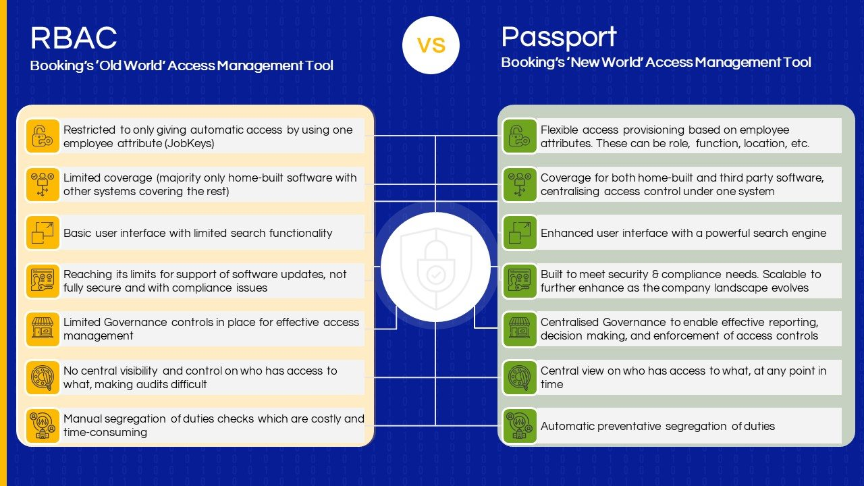

Slide 8
Production Rollout - Provdash
Steps for Production Deployment
Connect to staging server :
ssh -At provdash-staging.prod.booking.com
Begin the Deployment:
1> main
2> xml-docs
3> exit
Select 1. After Repo Selection ‘git-deploy start’.
Sync the Code:
git-deploy sync
Monitoring
Perl errors and warnings: https://flog.booking.com/?last-checked=1&last-minutes=60&persona=provdash&show_timeline=bar
https://grafana.booking.com/dashboard/db/web-servers-landweg?var-role=provdash&var-persona=provdash&var-tag=provdash
https://wiki.booking.com/display/PP/Deploy+Provdash+to+Production

Slide 9
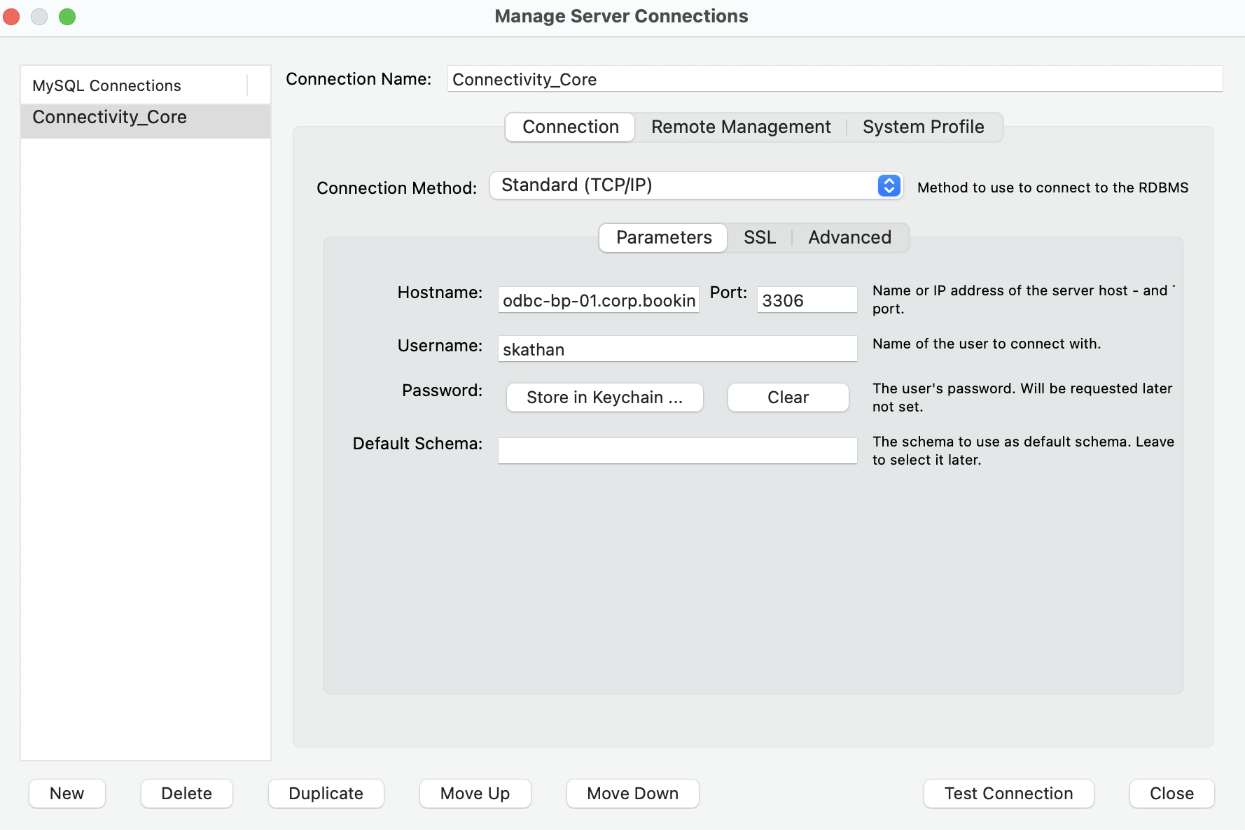
MYSQL Workbench - For Production Database

Slide 10
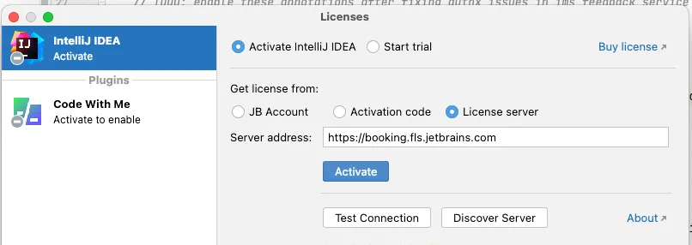
Intellij Licence
Go to https://booking.fls.jetbrains.com and log in via Okta. [*] In case you are not allowed to log in, request access to this Passport policy.
On your IDE, when prompted to add a license, use the "License Server" option and input the same URL in the text box. Click "Activate". You may be asked to "initiate authorization procedure", follow the instructions
.

Slide 11
Thank you!

